Slide 1
Welcome to
PowerPoint Presentation
ON
Unit-1, Lesson-1
Nelson Mandela, from apartheid fighter to president
Prepared by
Md. Tarikul Ghani

Slide 2
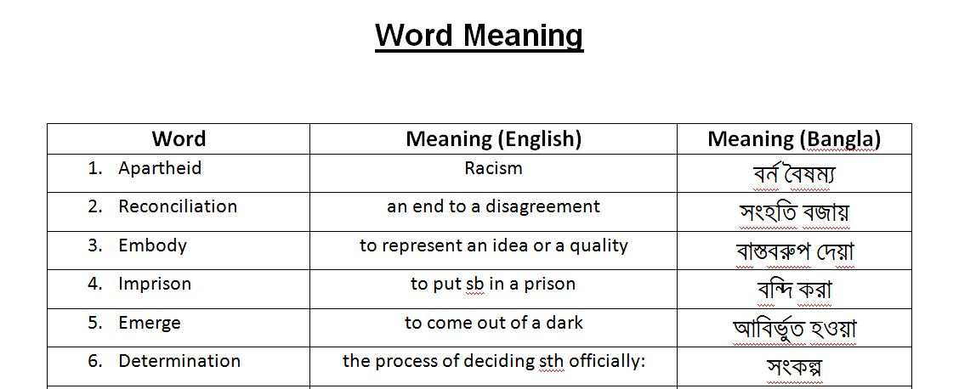

Slide 3
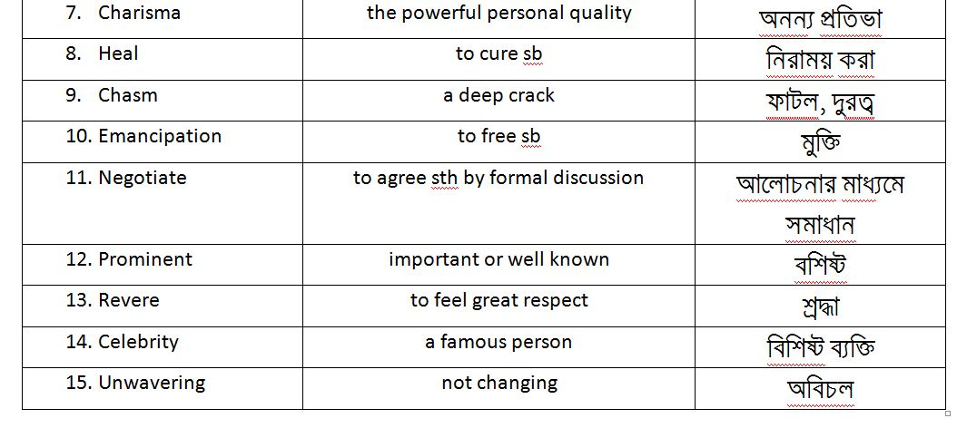

Slide 4
Multiple Choice Question
Choose the word which is closest in meaning in the context:
(i) What does the word embody refer to?
a) mean b) indicate c) represent d) modify
(ii) The word charisma means-
a) magic b) personality c) enchantment d) trick
(iii) The word emancipation means-
a) participation b) expectation c) encouragement d) liberation

Slide 5
(iv) What does the word prominent mean?
a) leading b) prosperous c) positive d) famous
(v) The word ideal refers to-
a) a person or thing regarded as perfect
b) a principle to be aimed at
c) a struggle for prosperity
d) the comfortable situation

Slide 6
Thank You

